Slide 1

WEB TECHNOLOGIES
Module 5
Express JS
Aisha Begam
Department of Computer Science and Engineering.

Slide 2

WEB TECHNOLOGIES
Install Express JS
Express is a web application framework for Node.
Its is server side or back end framework not comparable to client side frame works like React, Angular but can be used in combination to build full stack applications.
Express is fast, unopinionated and minimalist web framework for Node.js

Slide 3
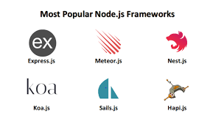
WEB TECHNOLOGIES
Install Express JS
Building web application with Node.js is MUCH easier.
Used for both server rendered apps as well as APIs.
Full control of request and response.
Most popular framework for Node.
Great to use with client side frameworks as its all Java Script.

Slide 4
WEB TECHNOLOGIES
Install Express JS
What to know first ?
JS fundamentals ( Objects, Arrays, Conditions etc)
Basic Node.js and NPM
HTTP status Codes
JSON

Slide 5
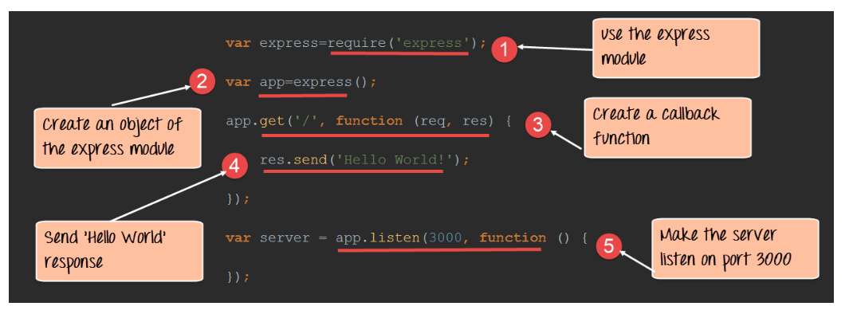
WEB TECHNOLOGIES
Install Express JS
Basic Server Syntax

Slide 6
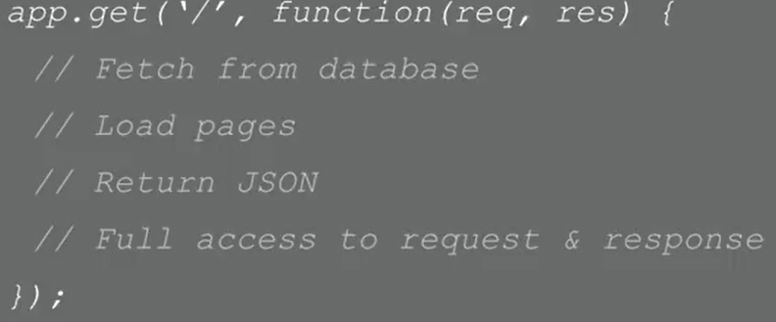
WEB TECHNOLOGIES
Install Express JS
Basic Route Handling
Handling requests/route is simple
app.get(), app.post(), app.put(), app.delete() etc.
Access to params, querystring, url parts etc
Express has routers so we can store routes in separate files and export
We can parse incoming data with Body Parser.

Slide 7
WEB TECHNOLOGIES
Install Express JS
Prerequisite:
Node.js installed on the system.
visit website for installation of node.js http://nodejs.org/en

Slide 8
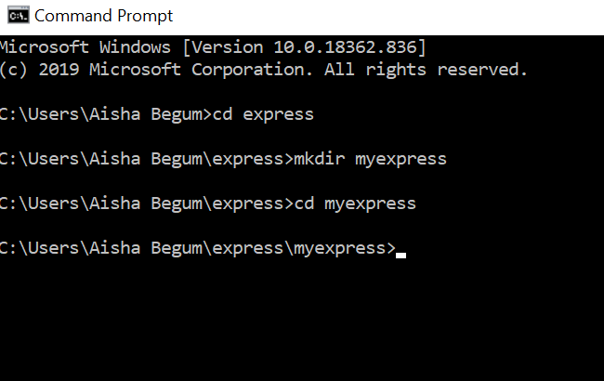
WEB TECHNOLOGIES
Install Express JS
Assuming you’ve already installed Node.js.
Create a directory to hold your application, and make that as your working directory.

Slide 9
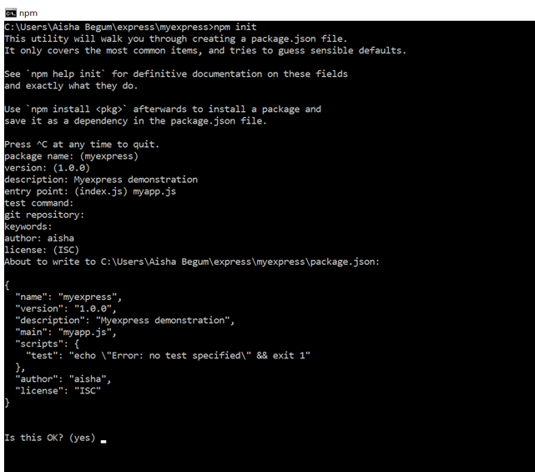
WEB TECHNOLOGIES
Install Express JS
Use the npm init command to create a package.json file for your application.
This command prompts you for a number of things, such as the name and version of your application. Hit RETURN to accept the defaults settings.
For more information on how package.json works, see Specifics of npm’s package.json handling.

Slide 10
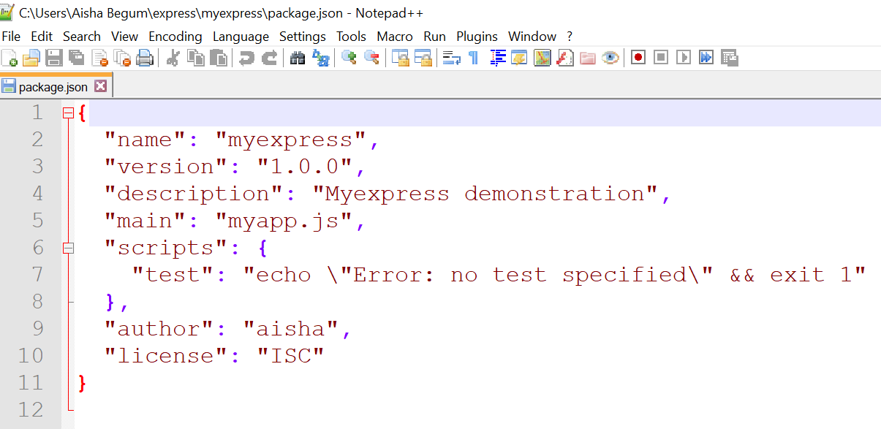
WEB TECHNOLOGIES
Install Express JS
The package.json file for your application is as shown below.
Used nodepad++ text editor

Slide 11
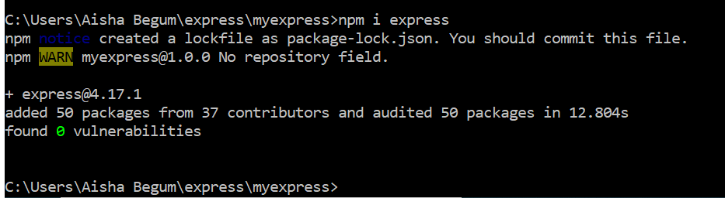
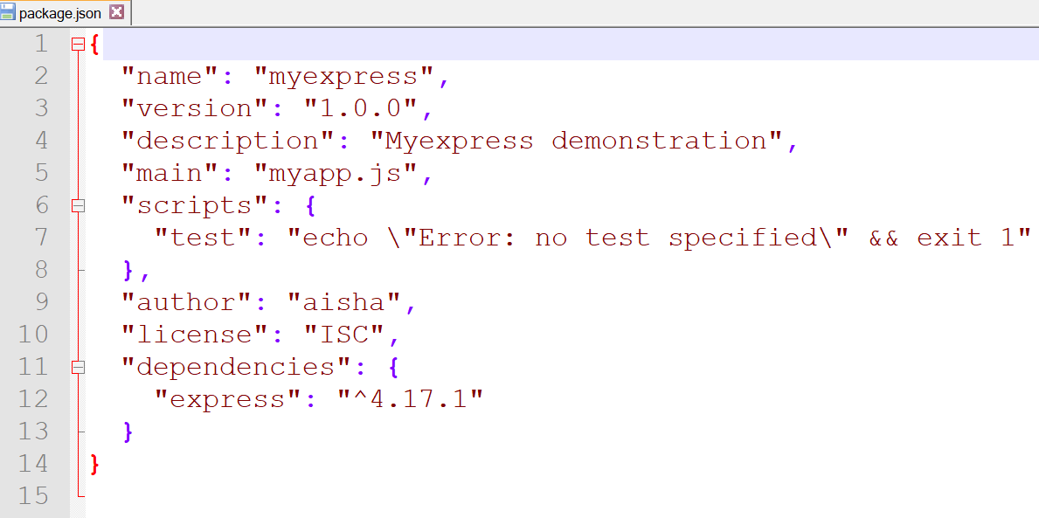
WEB TECHNOLOGIES
Install Express JS
Use the npm i express command to install express

Slide 12
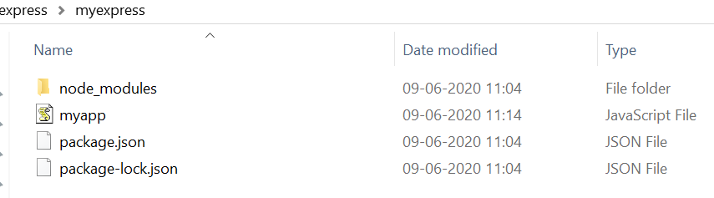
WEB TECHNOLOGIES
Install Express JS
Create a myapp.js file in the root folder of express.

Slide 13
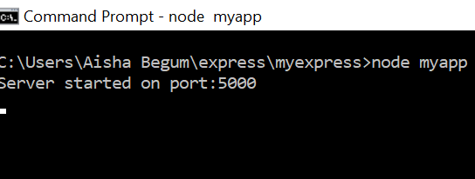
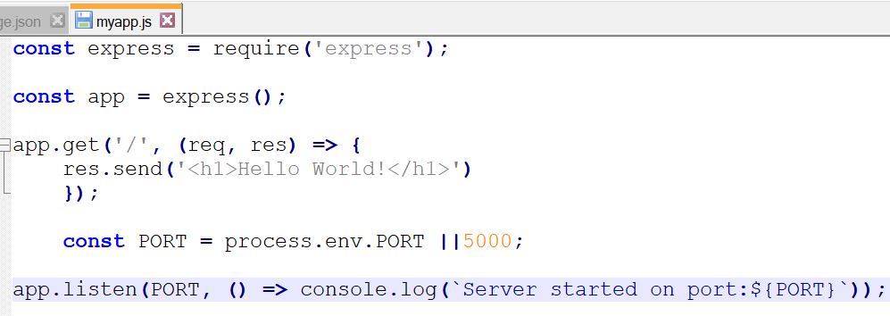
WEB TECHNOLOGIES
Install Express JS
First program to print hello world using express js

Slide 14
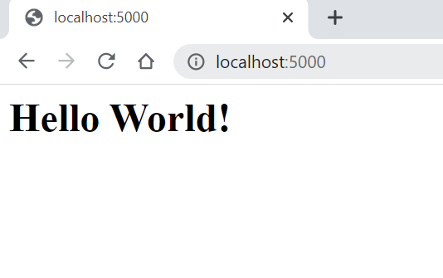
WEB TECHNOLOGIES
Install Express JS
We can check the output on any browser by using the url: http://localhost/5000.

Slide 15
WEB TECHNOLOGIES
Building Application Stack
Express JS
Building Application Stack

Slide 16
WEB TECHNOLOGIES
Building Application Stack
Building Application Stack
What is MERN Stack?
A stack is the mixture of technologies used to create Web applications.
Any web application will be made utilizing various technologies like (frameworks, libraries, databases).
The MERN stack is a JavaScript stack that is intended to make Application Development process smoother.

Slide 17
WEB TECHNOLOGIES
Building Application Stack
Building Application Stack
Mern Stack Components:
MERN incorporates four open-source Components
MongoDB,
Express,
React, and
Node.js.
These components gives an end to end frameworks for developers to work with.

Slide 18
WEB TECHNOLOGIES
Building Application Stack
Building Application Stack
Components Overview:
MongoDB A document-oriented, No-SQL database used to store the application data.
NodeJS: The JavaScript runtime environment. Used to run JavaScript on a machine rather than in a browser.
ExpressJS: A framework layered on top of NodeJS, used to build the backend of a site using NodeJS functions and structures.
ReactJS: A library created by Facebook. It is used to build UI components that create the user interface of the single page web application.

Slide 19
WEB TECHNOLOGIES
Building Application Stack
Building Application Stack
Benefits of MERN Stack
Java script is the programming language utilized both for client side and server-side.
For tech stack with different programming languages, developers need to find out how to interface them together. With the JavaScript stack, developers should be proficient in JavaScript and JSON.
Using the MERN stack enables developers to build highly efficient web applications.

Slide 20
THANK YOU
Aisha Begam
Department of Computer Science Engineering
aisha.b@pes.edu
+91 9741907626

